Slide 1
Bright or Dark, or Virtues and Vices?
A Reexamination of the Big Five and Job Performance
A Dissertation Defense by:
Christopher M. Castille, ABD
Visiting Assistant Professor of Human Resources Development
Villanova University
For the Degree of:
Doctorate of Philosophy
Committee Members:
Dr. Tilman L. Sheets (chair)
Associate Professor of Psychology
Department of Psychology and Behavioral Sciences
Dr. Steven Toaddy
Assistant Professor of Psychology
Department of Psychology and Behavioral Sciences
Dr. Rebecca J. Bennett
Professor of Management
Department of Management

Slide 2
Overview
Study Purpose
Methodology Refresh
Results
Discussion

Slide 3
Purpose
Develop a measurement model using a new heuristic: virtues and vices
Virtues generally reflect bright traits (e.g., Big Five) or normal variations of basic tendencies
Vices generally reflect extreme levels of these basic tendencies (e.g., dark triad traits reflect extremely low agreeableness)
Extend the “too-much-of-a-good-thing” hypothesis (Pierce & Aguinis, 2013; Grant & Schwartz, 2011) to other “bright” (Big Five) traits beyond Conscientiousness and Emotional Stability

Slide 4
Measures
Big Five Inventory–10 (BFI–10), a 10-item measure of the Big Five (e.g., I am generally trusting)
Test-retest reliabilities (k = 3) from .68–.83 (Rammstedt & John, 2007)
Comparable structural and convergent validity to a larger BFI-40 inventory
A 5-item measure of Task Performance Behavior was constructed (e.g., I complete duties as they are assigned)
Items borrowed from scales that have correlated with measures of OCB and CWB when assessed from the supervisor perspective (see Anderson & Williams, 1991; Carter et al., 2013)

Slide 5
Measures
20-item version of the Organizational Citizenship Behavior Checklist (OCB-C) (e.g., Volunteered for extra work assignments)
Internal consistency = .83 for self-reports (Spector et al., 2010)
Correlates with another OCB measure (Podsakoff et al., 1990)
Bennett and Robinson’s (2000) 19-item Measure of Workplace Deviance (e.g., Publicly embarrassed someone at work)
Meta-analytic reliability of .83; overall WPD construct correlates with each of the Big Five constructs in expected fashions (see Berry et al., 2007)
All criteria assessed with a frequency scale (1 = never; 7 = everyday)

Slide 6
Procedure
Specified the FFM content domains (i.e., 30 narrow factors) using published definitions (see Judge et al., 2013)
Four graduate assistants in Human Resources Development were trained in item writing strategies for creating ideal point items, resulting in an item pool of 957 viable items

Slide 7
Procedure
Two doctoral candidates in I/O psychology with training in psychometric and personality theory provided fakability and trait extremity content ratings (7-point scales)
Items with low SME disagreement (AD Index < 1.00) (Burke & Dunlap, 2002) on both fakability and trait extremity were considered as candidate items
Items were chosen to adequately reflect each level of each narrow trait and, where applicable, to have a mix of items varying in rated fakability

Slide 8
Procedure
Administered to individuals conveniently sampled from Amazon’s Mechanical Turk (6-point scale: 1 = very inaccurate; 6 = very accurate)
Participants were paid ~$1.30
To ensure data quality, individuals who were flagged for inattentively responding to bogus items (Craig & Meade, 2012) were removed from the survey

Slide 9
Analyses
Ideal Point IRT
GGUM 2004 (Roberts, 2000) used to generate graphics, allowing for a graphical evaluation of model fit
Convergent and Discriminant Validity of Constructs and Measures
CFA used to evaluate each criterion measurement model
Scale scores for the Big Five personality measures correlated and the pattern of correlation was examined

Slide 10
Analyses
Hierarchical Polynomial Regression Analyses
A conservative Type I error rate was chosen (p < .01) due to number of regressions
All scores were standardized and the polynomial (i.e., curvilinear) term was calculated from that standardized value to avoid multicollinearity (Aiken & West, 1991)
A significant (p < .01) change in the incremental R² for the inclusion of the polynomial terms supports a nonlinear relationship

Slide 11
Descriptive Statistics of Study Participants
N = 727
Age (M = 34.34, SD = 10.46)
Majority were Caucasian (n = 584, or 80.3%)
Female dominated sample (n = 421, or 57.9%)
Generally well educated (n = 554, 76.2%, achieved at least a 2-year degree)
An overwhelming majority noted that Mechanical Turk was not their primary source of income (n = 701, or 96.4%)
Median tenure of 3.75 years (range = 0 to 38)
Majority worked as full-time (n = 562, or 77.3%)
Majority worked in the private sector (n = 498, 68.5%)
Median reported income was $38,000 (interquartile range of $32,500)

Slide 12
Convergent and Discriminant Validity of Job Performance Measures
Task Performance
The fit of the 5-item model was acceptable [χ²(5) = 20.92, p < 0.001; CFI = 0.99; TLI = 0.98; RMSEA = 0.07] as were all standardized loadings were acceptable (standardized λs > 0.56, p < 0.001)
OCB
Initial testing indicated poor fit due to a highly correlated residual [χ²(170) = 1258.53, p < 0.001; CFI = 0.85; TLI = 0.83; RMSEA = 0.09]
A revised model (one item dropped) yielded acceptable fit [χ²(152) = 592.40, p < 0.001; CFI = 0.92; TLI = 0.91; RMSEA = 0.07] and all items significantly reflected OCB (standardized λs > 0.50, p < 0.001)
Notes:
Scanning the modification indices indicated that the residuals for items five (“Lent a compassionate ear when someone had a work problem.”) and six (“Lent a compassionate ear when someone had a personal problem.”) correlated very strongly
I observed a similar problem with the residuals from item eight (“Offered suggestions to improve how work is done.”) and item nine (“Offered suggestions for improving the work environment.”)
Rather than allowing these residuals to correlate, I followed the advice of Landis et al. (2006) who noted that such problematic items should be dropped
I decided to randomly drop one item from each overlapping pair (5 & 9)

Slide 13
Convergent and Discriminant Validity of Job Performance Measures
CWB
A bifactor model was specified in which all items reflected both the general CWB factor and one of two latent target factors (interpersonal or organizational)
One item dropped due to an administrative error
This model evidenced adequate model-data fit [χ²(119) = 367.15, p < 0.001; CFI = 0.95; TLI = 0.94; RMSEA = 0.05]
All items significantly reflected a general factor (standardized λs > 0.26, p < 0.001)

Slide 14
Convergent and Discriminant Validity of Job Performance Measures
An overall model with all criteria assessed simultaneously indicated acceptable fit
[χ²(756) = 1789.38, p < 0.001; CFI = 0.92; TLI = 0.92; RMSEA = 0.04]
Latent construct correlations between task performance and CWB (ϕ = -0.42, p < .001), task performance and OCB (ϕ = 0.26, p < 0.001), and CWB and OCB (ϕ = 0.02, p = ns) were consistent with expectations
Notes:
ϕ = latent construct correlations

Slide 15
Scale Development of Unfolding Big Five Assessments
Items for each unfolding Big Five measure were analyzed using the GGUM 2004 software (Roberts, 2000)
Graphical depictions were used to evaluate model-data fit
Bottom-up approach to scale construction (Carter et al., 2014) adopted following the DeYoung et al. (2007) model for all Big Five scales except Agreeableness, because the models would not converge
Notes:
Graphical analysis depicting the expected and observed scores are shown below to allow a more transparent examination of model-data fit
Acceptable model-data fit has been achieved when the observed theta-delta values (depicted as dots) do not deviate far from the predicted theta-delta values
A truly unfolding scale would uncover nonlinear response functions that are graphically depicted by a nonlinear TCC
If the TCC (which depicts the relationship between trait and true scores) is bell shaped with an inflexion point occurring near the mean, then the scale reflects an ideal-point response process (Carter et al., 2014)
Lastly, in order to show that the assessments reliably estimate different trait levels, the test information curves (TICs), which should be relatively flat across the latent dimension, are shown

Slide 16
Scale Development of Unfolding Big Five Assessments
Neuroticism
Step 3
Step 2
Volatility
Withdrawal
Step 1
Angry Hostility
Impulsiveness
Anxiety
Depression
Self-Consciousness
Vulnerability
Notes:
Graphical analysis depicting the expected and observed scores are shown below to allow a more transparent examination of model-data fit
Acceptable model-data fit has been achieved when the observed theta-delta values (depicted as dots) do not deviate far from the predicted theta-delta values
A truly unfolding scale would uncover nonlinear response functions that are graphically depicted by a nonlinear TCC
If the TCC (which depicts the relationship between trait and true scores) is bell shaped with an inflexion point occurring near the mean, then the scale reflects an ideal-point response process (Carter et al., 2014)
Lastly, in order to show that the assessments reliably estimate different trait levels, the test information curves (TICs), which should be relatively flat across the latent dimension, are shown

Slide 17
IRT Assessments Summary Results
Big Five Trait | k | α_{average} | Extremely Low δ ≥ -2.0 | Moderate Level (unfolding) -2.0 ≥ δ ≤ 2.0 | Extremely High δ ≤ 2.0
Extraversion | 33 | 0.66 [0.19—1.45] | “I hate leading groups” | “Half of the time I prefer leisurely activities and half of the time I prefer activities to be fast-paced” | “I always try to live life to the fullest extent that I possibly can”
Conscientiousness | 30 | 0.66 [0.24—1.19] | “I avoid setting goals, but when I do, I set extremely easy goals” | “I sometimes make decisions based on instinct rather facts; and sometimes I prefer facts” | “Regardless of the situation, I always tell the truth”
Agreeableness | 39 | 0.70 [0.26—1.44] | “I always hide my motives to get what I want” | “I shy away from credit sometimes, but other times it is nice to be recognized” | “I always put the needs of others before my own”
Benchmark for α
Low to Moderate α [.25–1.34] (Baker, 2001)
Notes:
α_{average} (alpha) is the discrimination parameter, which describes how well the item is able to discriminate among respondents who possess different levels of the trait of interest.
δ (delta) refers to the item location estimate; in other words, the level of a trait that an individual must possess in order to fully endorse the item.
Compared to Carter et al.’s (2014) conscientiousness measure:
α_{average} =

Slide 18
IRT Assessments Summary Results
Big Five Trait | k | α_{average} | Extremely Low δ ≥ -2.0 | Moderate Level (unfolding) -2.0 ≥ δ ≤ 2.0 | Extremely High δ ≤ 2.0
Openness | 26 | 0.67 [0.17–1.42] | “I have no desire to visit new places” | “I like change, but I also need stability” | “I really enjoy trying to tackle the most complex problems imaginable”
Neuroticism | 33 | 0.81 [0.23–1.42] | “I never worry about anything” | “On occasion I feel blue, but most of the time I don’t feel blue” | “I can panic extremely easily”
Benchmark for α
Low to Moderate α [.25–1.34] (Baker, 2001)
Notes:
α_{average} (alpha) is the discrimination parameter, which describes how well the item is able to discriminate among respondents who possess different levels of the trait of interest.
δ (delta) refers to the item location estimate; in other words, the level of a trait that an individual must possess in order to fully endorse the item.

Slide 19
Convergent-Discriminant Validity of Big Five Measures
Variable | 1 | 2 | 3 | 4 | 5 | 6 | 7 | 8 | 9 | 10
1 U-E | .86
2 U-C | .33*** | .88
3 U-A | .24*** | .48*** | .87
4 U-O | .50*** | .42*** | .41*** | .83
5 U-N | -.60*** | -.49*** | -.34*** | -.26*** | .91
6 BF10-E | .68*** | .09* | .07* | .27*** | -.34*** | .69
7 BF10-C | .33*** | .61*** | .26*** | .21*** | -.47*** | .18*** | .49
8 BF10-A | .31*** | .16*** | .53*** | .23*** | -.36*** | .22*** | .16*** | .53
9 BF10-O | .26*** | .11** | .10** | .45*** | -.09* | .19*** | .05 | .05 | .49
10 BF10-ES | .47*** | .29*** | .20*** | .20*** | -.75*** | .27*** | .35*** | .30*** | .03 | .69
Note. N = 701 to 727. The “U-” corresponds to the unfolding measures while the BF10 corresponds to the BF10 measures. Cronbach alphas bolded and placed on the diagonal. * p < .05 ** p < .01 *** p < .001.
Extraversion scales converged most strongly with one another and to a lesser extent with the other Big Five scales.

Slide 20
Convergent-Discriminant Validity of Big Five Measures
Variable | 1 | 2 | 3 | 4 | 5 | 6 | 7 | 8 | 9 | 10
1 U-E | .86
2 U-C | .33*** | .88
3 U-A | .24*** | .48*** | .87
4 U-O | .50*** | .42*** | .41*** | .83
5 U-N | -.60*** | -.49*** | -.34*** | -.26*** | .91
6 BF10-E | .68*** | .09* | .07* | .27*** | -.34*** | .69
7 BF10-C | .33*** | .61*** | .26*** | .21*** | -.47*** | .18*** | .49
8 BF10-A | .31*** | .16*** | .53*** | .23*** | -.36*** | .22*** | .16*** | .53
9 BF10-O | .26*** | .11** | .10** | .45*** | -.09* | .19*** | .05 | .05 | .49
10 BF10-ES | .47*** | .29*** | .20*** | .20*** | -.75*** | .27*** | .35*** | .30*** | .03 | .69
Note. N = 701 to 727. The “U-” corresponds to the unfolding measures while the BF10 corresponds to the BF10 measures. Cronbach alphas bolded and placed on the diagonal. * p < .05 ** p < .01 *** p < .001.
Conscientiousness scales converged most strongly with one another and to a lesser extent with the other Big Five scales.

Slide 21
Convergent-Discriminant Validity of Big Five Measures
Variable | 1 | 2 | 3 | 4 | 5 | 6 | 7 | 8 | 9 | 10
1 U-E | .86
2 U-C | .33*** | .88
3 U-A | .24*** | .48*** | .87
4 U-O | .50*** | .42*** | .41*** | .83
5 U-N | -.60*** | -.49*** | -.34*** | -.26*** | .91
6 BF10-E | .68*** | .09* | .07* | .27*** | -.34*** | .69
7 BF10-C | .33*** | .61*** | .26*** | .21*** | -.47*** | .18*** | .49
8 BF10-A | .31*** | .16*** | .53*** | .23*** | -.36*** | .22*** | .16*** | .53
9 BF10-O | .26*** | .11** | .10** | .45*** | -.09* | .19*** | .05 | .05 | .49
10 BF10-ES | .47*** | .29*** | .20*** | .20*** | -.75*** | .27*** | .35*** | .30*** | .03 | .69
Note. N = 701 to 727. The “U-” corresponds to the unfolding measures while the BF10 corresponds to the BF10 measures. Cronbach alphas bolded and placed on the diagonal. * p < .05 ** p < .01 *** p < .001.
Agreeableness scales converged most strongly with one another and to a lesser extent with the other Big Five scales.

Slide 22
Convergent-Discriminant Validity of Big Five Measures
Variable | 1 | 2 | 3 | 4 | 5 | 6 | 7 | 8 | 9 | 10
1 U-E | .86
2 U-C | .33*** | .88
3 U-A | .24*** | .48*** | .87
4 U-O | .50*** | .42*** | .41*** | .83
5 U-N | -.60*** | -.49*** | -.34*** | -.26*** | .91
6 BF10-E | .68*** | .09* | .07* | .27*** | -.34*** | .69
7 BF10-C | .33*** | .61*** | .26*** | .21*** | -.47*** | .18*** | .49
8 BF10-A | .31*** | .16*** | .53*** | .23*** | -.36*** | .22*** | .16*** | .53
9 BF10-O | .26*** | .11** | .10** | .45*** | -.09* | .19*** | .05 | .05 | .49
10 BF10-ES | .47*** | .29*** | .20*** | .20*** | -.75*** | .27*** | .35*** | .30*** | .03 | .69
Note. N = 701 to 727. The “U-” corresponds to the unfolding measures while the BF10 corresponds to the BF10 measures. Cronbach alphas bolded and placed on the diagonal. * p < .05 ** p < .01 *** p < .001.
Openness scales converged most strongly with one another and to a lesser extent with the other Big Five scales.

Slide 23
Convergent-Discriminant Validity of Big Five Measures
Variable | 1 | 2 | 3 | 4 | 5 | 6 | 7 | 8 | 9 | 10
1 U-E | .86
2 U-C | .33*** | .88
3 U-A | .24*** | .48*** | .87
4 U-O | .50*** | .42*** | .41*** | .83
5 U-N | -.60*** | -.49*** | -.34*** | -.26*** | .91
6 BF10-E | .68*** | .09* | .07* | .27*** | -.34*** | .69
7 BF10-C | .33*** | .61*** | .26*** | .21*** | -.47*** | .18*** | .49
8 BF10-A | .31*** | .16*** | .53*** | .23*** | -.36*** | .22*** | .16*** | .53
9 BF10-O | .26*** | .11** | .10** | .45*** | -.09* | .19*** | .05 | .05 | .49
10 BF10-ES | .47*** | .29*** | .20*** | .20*** | -.75*** | .27*** | .35*** | .30*** | .03 | .69
Note. N = 701 to 727. The “U-” corresponds to the unfolding measures while the BF10 corresponds to the BF10 measures. Cronbach alphas bolded and placed on the diagonal. * p < .05 ** p < .01 *** p < .001.
Neuroticism/Emotional Stability scales converged most strongly with one another and to a lesser extent with the other Big Five scales.

Slide 24
Hypothesis Testing
Two broad models being tested:
Linear model with directional (or nil) hypotheses grounded in prior data
Hypothesized nonlinear model that is an extension of the “too-much-of-a-good-thing” hypothesis

Slide 25
H1: Extraversion and Job Performance
Hypothesis 1a predicts no relationship between Extraversion and task performance behavior
Rejected
Hypothesis 1b predicts a positive relationship between Extraversion and OCB
Supported
Hypothesis 1c predicts no relationship between Extraversion and CWB
Rejected
Notes:
Under the general linear model, Extraversion is expected to be positively related only to OCB. This linear effect was observed (β = .28, p < .001); thus, Hypothesis 1b was supported. Additionally, effects of Extraversion on task performance (β = .11, p < .01) and CWB (β = -.17, p < .001), though not hypothesized, were also detected; thus, (null) Hypotheses 1a and 1c were rejected.

Slide 26
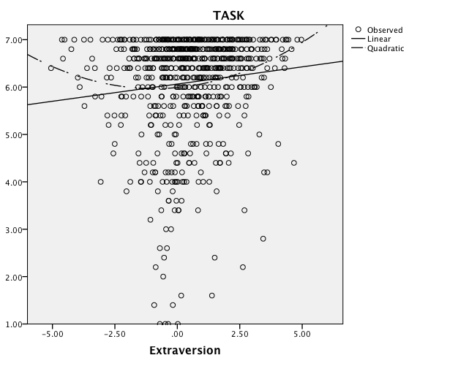
H1: Extraversion and Job Performance
Hypothesis 1d links Extraversion nonlinearly to task performance
Contrary

Slide 27
H1: Extraversion and Job Performance
Hypothesis 1e links Extraversion nonlinearly to OCB in similar ways
Not supported
Hypothesis 1f predicts a nonlinear effect linking Extraversion to CWB
Not supported

Slide 28
H2: Conscientiousness and Job Performance
Hypothesis 2a predicts a positive relationship between Conscientiousness and and task performance behavior
Supported
Hypothesis 2b predicts a positive relationship between Conscientiousness and OCB
Supported
Hypothesis 2c predicts no relationship between Extraversion and CWB
Supported

Slide 29
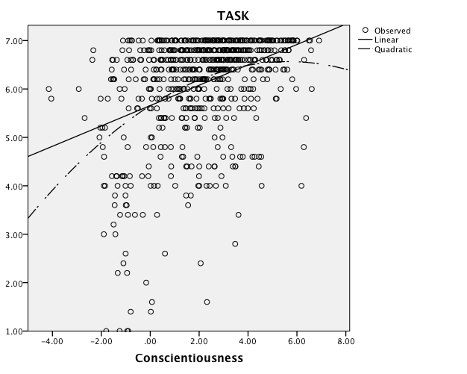
H2: Conscientiousness and Job Performance
Hypothesis 2d links Conscientiousness nonlinearly to task performance
Supported

Slide 30
H2: Conscientiousness and Job Performance
Hypothesis 2e links Conscientiousness nonlinearly to OCB in similar ways
Not supported

Slide 31
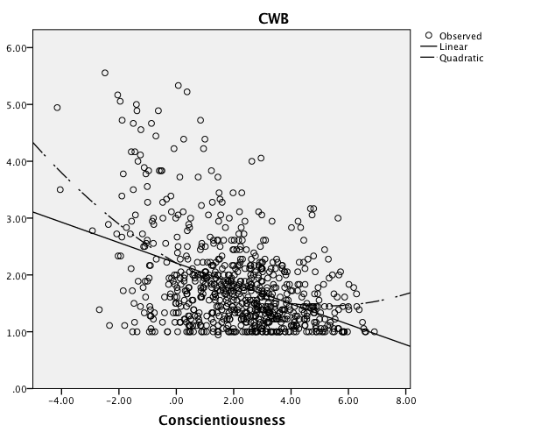
H2: Conscientiousness and Job Performance
Hypothesis 2f predicts a nonlinear effect linking Conscientiousness to CWB
Supported

Slide 32
H3: Agreeableness and Job Performance
Hypothesis 3a predicts a positive relationship between Agreeableness and task performance behavior
Supported
Hypothesis 3b predicts a positive relationship between Agreeableness and OCB
Supported
Hypothesis 3c predicts a negative relationship between Agreeableness and CWB
Supported

Slide 33
H3: Agreeableness and Job Performance
Hypothesis 3d links Agreeableness nonlinearly to task performance
Not supported
Hypothesis 3e links Agreeableness nonlinearly to OCB
Not supported
Hypothesis 3f links Agreeableness nonlinearly to CWB
Not supported

Slide 34
H4: Openness to Experience and Job Performance
Hypothesis 4a predicts that Openness to Experience is not related to task performance behavior
Rejected
Hypothesis 4b predicts that Openness to Experience is not related to OCB
Rejected
Hypothesis 4c predicts that Openness to Experience is not related to CWB
Rejected

Slide 35
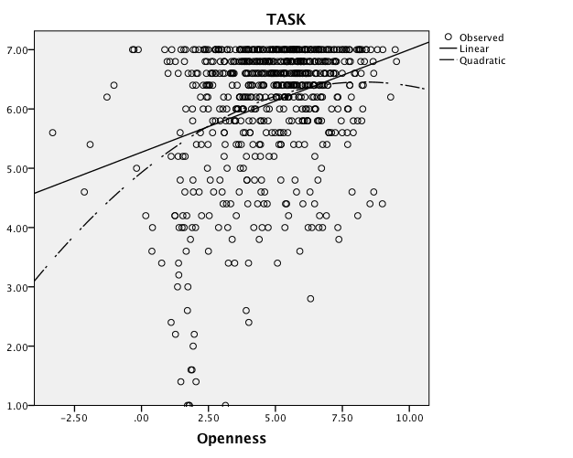
H4: Openness to Experience and Job Performance
Hypothesis 4d links Openness to Experience nonlinearly to task performance
Supported

Slide 36
H4: Openness to Experience and Job Performance
Hypothesis 4e links Openness to Experience nonlinearly to OCB
Not supported

Slide 37
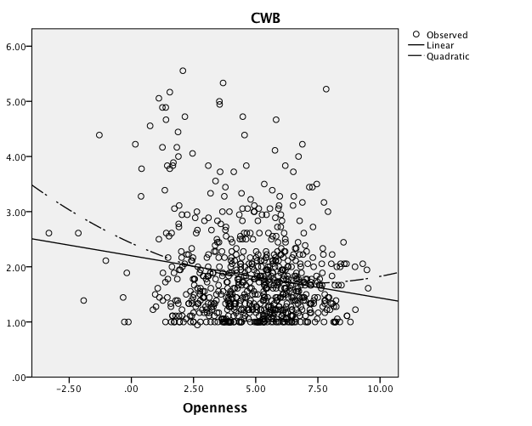
H4: Openness to Experience and Job Performance
Hypothesis 4f predicts a nonlinear effect linking Openness to CWB,
Supported

Slide 38
H5: Neuroticism and Job Performance
Hypothesis 5a predicts a negative relationship between Neuroticism and task performance behavior
Supported
Hypothesis 5b predicts a negative relationship between Neuroticism and OCB
Supported
Hypothesis 5c predicts a positive relationship between Neuroticism and CWB
Supported
0
Notes:
Under the general linear model, Extraversion is expected to be positively related only to OCB. This linear effect was observed (β = .28, p < .001); thus, Hypothesis 1b was supported. Additionally, effects of Extraversion on task performance (β = .11, p < .01) and CWB (β = -.17, p < .001), though not hypothesized, were also detected; thus, (null) Hypotheses 1a and 1c were rejected.

Slide 39
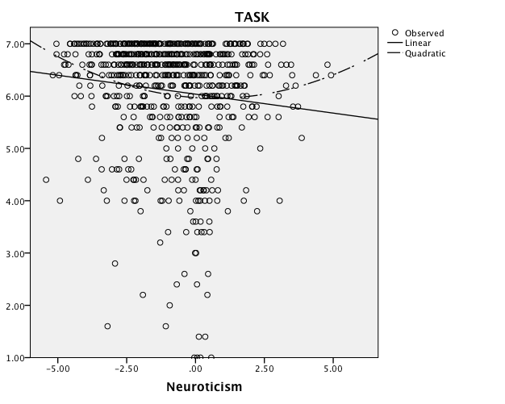
H5: Neuroticism and Job Performance
Hypothesis 5d links Neuroticism nonlinearly to task performance
Contrary
Notes:
Under the general linear model, Extraversion is expected to be positively related only to OCB. This linear effect was observed (β = .28, p < .001); thus, Hypothesis 1b was supported. Additionally, effects of Extraversion on task performance (β = .11, p < .01) and CWB (β = -.17, p < .001), though not hypothesized, were also detected; thus, (null) Hypotheses 1a and 1c were rejected.

Slide 40
H5: Neuroticism and Job Performance
Hypothesis 5e links Neuroticism nonlinearly to OCB
Not supported
Hypothesis 5f predicts a nonlinear effect linking Neuroticism to CWB
Not supported

Slide 41
Discussion – Practical Implications
Prior to this investigation, nonlinear relationships between the Big Five and job performance behaviors were only tested for Conscientiousness (Carter et al., 2013; Le et al., 2011) and Emotional Stability (Le et al., 2011)
The results of this study support the notion that nonlinear relationships between certain broad Big Five traits and specific job performance behaviors may exist
Conscientiousness and Openness to Experience may be “too-much-of-a-good-thing” for certain jobs
The nonlinear effects may suggest that practitioners in selection should consider pursuing a double cutoff strategy to screen out applicants (Le et al., 2011)
Unfortunately, setting the appropriate cutoffs is not an easy task (Berry, Sackett, & Johnson, 2009)
Contrary effects suggests that this may be an overly simplistic hypothesis to generalize to all traits
More nuanced theory is needed
Nevertheless, organizational figures may consider investigating nonlinearities in their settings as selection decisions based on top-down scoring may be counterproductive
Notes:
Theoretically, understanding the functional form of the relationship between personality traits and job performance allow for more nuanced theory development by specifying boundary conditions for proposed effects
Practically, the existence of nonlinear effects might call into question the use of top-down selection models with regard to personality traits and suggest that more sophisticated selection methods are needed

Slide 42
Discussion – Legal Implications
Broader assessment of personality functioning may be viewed as tapping into maladaptive functioning
Selection using such measures may have implications for the Americans with Disabilities Act (ADA)
The ADA defines a mental impairment as representing something that substantially limiting a major life activity, which includes tasks such as walking, learning, thinking, and working
Wu and LeBreton (2011) argued that personality assessments such as the one developed here are unlikely to violate ADA because such assessments were not designed to diagnose psychopathology
Where or how we draw the line is uncertain
While some may view this as a significant problem with the practical application of the findings from this study (and others like it), I view this as a necessary progression for the larger field of psychology – we need to have these discussions
Notes:
However should clinicians develop a library of trait levels that reflect maladaptive personality functioning and such trait levels can be estimated reliably with broadened assessments such as the one devised here, then collaborative work would be needed to establish the boundary conditions for personality assessment in organizational settings

Slide 43
Discussion – Limitations
Previous investigations revealed nonlinearities between Conscientiousness and Emotional Stability with OCB, such findings were not replicated in this investigation
This may be due to be due to our use of a same-source design, whereas these previous authors (i.e., Carter et al., 2013; Le et al., 2011) utilized a distinct-source design
Distinct source designs aren’t necessarily superior (Lance & Siminovsky, 2015)
However, same-source design may also be problematic (Siemsen, Roth, & Oliveira, 2010)
Future research using longitudinal multisource designs (Kammeyer-Mueller, Steel, & Rubenstein, 2010) are needed
Notes:
These results suggest that even small effects, such as nonlinear effects, can have practical importance (Cortina & Landis, 2006) even in small sample settings by producing cohorts of workers who will achieve higher levels of task performance relative to cohorts produced by simple linear models. This finding corroborates the results of Carter et al. (2013), who also observed practically significant outcomes for small sample selection when modeling nonlinearities between Conscientiousness and job performance. However, the models yielded equivalent results for predicting CWB, which suggests that quadratic models, though providing better fit to the data (in terms of R²) may not consistently be of practical importance. The same pattern emerged for the nonlinear relationship linking Extraversion to task performance. Interestingly, the linear relationship linking Emotional Stability to task performance produced cohorts evidencing higher task performance than the quadratic model. Thus, it might be argued that quadratic models may not necessarily consistently be of practical importance and could even produce counterproductive outcomes (e.g., cohorts of individuals performing at lower levels).
Single-source designs, though commonly viewed as inferior to distinct-source designs, can allow for more reliable approximations to true score counterparts (Lance & Siminovsky, 2015), Research suggests that distinct-source designs tend to produce findings that may be partly explained as halo effects (C. M. Berry et al., 2012; Carpenter et al., 2014; Viswesvaran, Schmidt, & Ones, 2005)

Slide 44
Discussion – Limitations
Another important limitation to the study involved the construction of the unfolding Big Five personality measures
Relied largely on graphical depictions of model-data fit and unfolding to build unfolding scales
Never tested the assumptions of unidimensionality and local independence because fully appropriate tests do not exist
Research is needed on the development of relative fit indices for IRT models such as the GGUM (Zickar & Broadfoot, 2009)

Slide 45
Questions?

